Slide 1


Slide 2
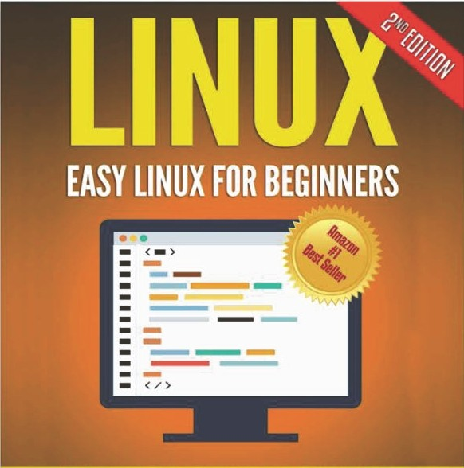
Book we will be following

Slide 3
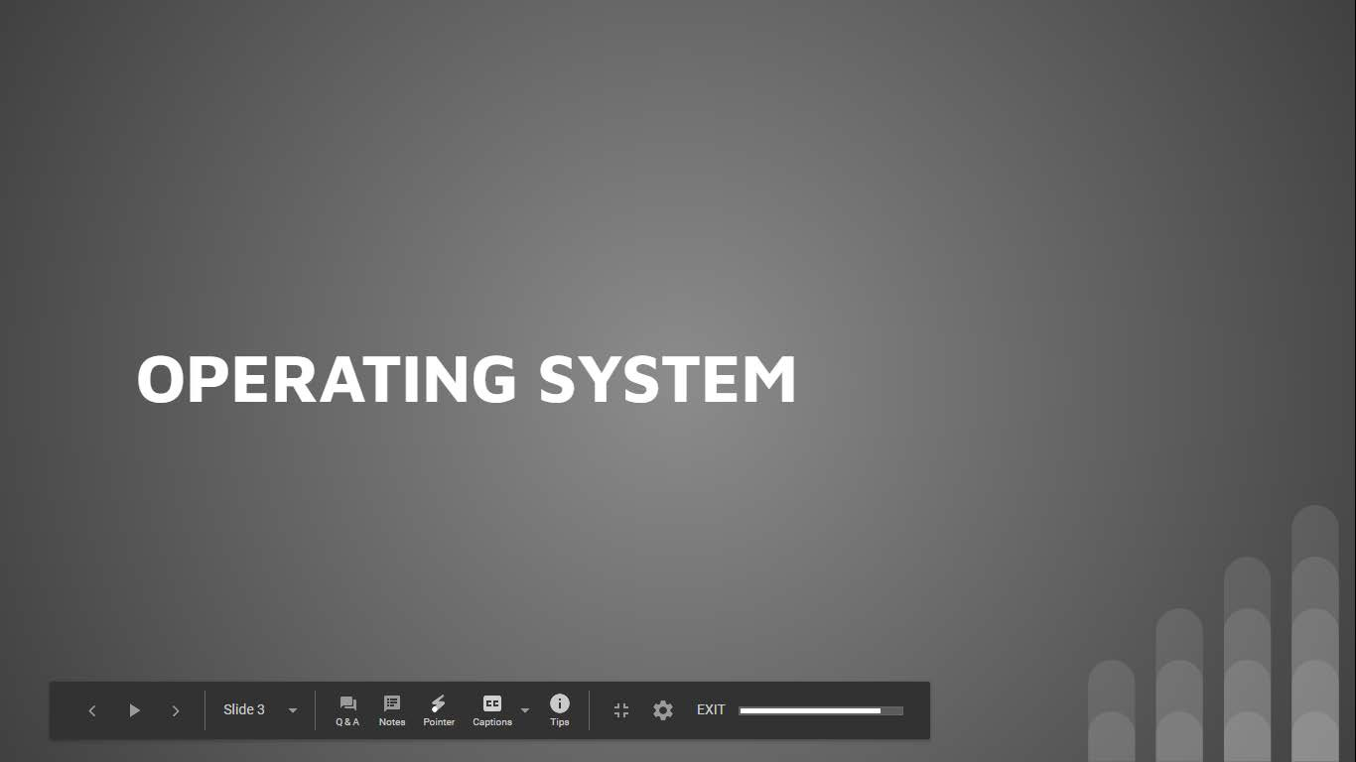

Slide 4
Linux
WHAT IS AN OPERATING SYSTEM?
A computer, complete with all its parts - the CPU, mouse, monitor, and keyboard - will not work without a central program that will piece it all together
In order to use a PC, you need a software inside which will take care of making the hardware work for you
A special kind of soft ware which is between the hardware of the PC, and the programs that you want to use and work with
This piece of software is the Operating System, or more easily referred to as just an OS
In short, an operating system is the software that brings together a computer's hardware and the diff erent programs that you want to install on it
Without it, when you booted up your PC, you would not get anything on the monitor, and neither mouse nor keyboard will work.
SOURCE: Easy Linux For Beginners book by Felix Alvaro

Slide 5
Linux
WHAT OPERATING SYSTEM DOES?
Detect hardware
o An OS is responsible for validating the components of a computer during boot up (hard drive, CPU, network cards, mouse, etc.) and loading the corresponding drivers and modules for the hardware to properly run
Manage processes
Similar to the way our mind works, several processes or applications are running on a computer at the same time
It is the OS that is responsible for allocating CPU resources and sharing it among the processes
The OS also provides the user the option to start, stop, or restart a process
Manage memory
Each application needs a specific amount of RAM and swap memory to function
The OS is responsible for assigning memory allocations, and for handling memory requests
SOURCE: Easy Linux For Beginners book by Felix Alvaro

Slide 6
Linux
WHAT OPERATING SYSTEM DOES?
Initiate user interfaces
An OS offers users ways to access the system either via a command line or a graphical user interface (GUI) Establish file systems
The OS handles the managementof files (access, directories, and structure),including the access to the file system
Manage access and user authentication
o An OS allows for creating user accounts with differentpermissionsfor accessto files and processes
SOURCE: Easy Linux For Beginners book by Felix Alvaro

Slide 7
Linux
WHAT OPERATING SYSTEM DOES?
Provide a platform for administrative use
A computer's OS provides a platform for the administrator to
Add users,
Allocate disk space,
Inst all software,
Perform activitiesto manage the computer
Start-up services
The OS manages several processes running in thebackground known as daemon processes
SOURCE: Easy Linux For Beginners book by Felix Alvaro

Slide 8

Lin ux
THE NAMES YOU HEARD THE MOST
Windows 10
Mac OS
Unix.
Linux
SOURCE: Easy Linux For Beginners book by Felix Alvaro

Slide 9


Slide 10
Linux
WHAT IS LINUX?
Linux is an operating system, like the examples mentioned in the previous slide, and is often described as Unix-like
The difference between Linux and other operating systems lies in the fact that Linux is an open-source operating system
This means that Linux is continuously developed collaboratively
Unlike Windows and Mac0S which are both tied to the respective companies (Windows and Apple)
Not one single company owns Linux' development and support
Different companies sharing research, development, and the associated costs to upgrade linux operating system
SOURCE: Easy Linux For Beginners book by Felix Alvaro

Slide 11
Linux
WHAT IS LINUX?
This open source cooperation among companies and developers has led to making Linux one of the best ecosystems for use from small digital wristwatches to servers and supercomputers
Based on statistics, there are at least 100 companies and more than 1000 developers
who work together for every kernel release
Linux is composed of a kernel, the core control software, plus plenty of libraries and utilities that provide different features
The kernel is the lowest level of the operating system
The kernel is the main part of the operating system and is responsible for translat ing the command into something that can be understood by the computer
SOURCE: Easy Linux For Beginners book by Felix Alvaro

Slide 12
SIMPLIST OS ARCHITECTURE
Linux
Applications
Kernel
CPU
Memory
Devices
SOURCE: Easy Linux For Beginners book by Felix Alvaro

Slide 13
Linux
WHAT IS LINUX?
The main functions of the kernel are:
0
0
0
0
0
Memory management Network management Device driver
File management Process management
Linux is available through many distributions. These are what we can call Linux flavours
Distributions are groups of specific kernels and programs. The most popular ones include Arch, SUSE, Ubunt u, and Red Hat
Even Android a mobile operating system developed by Google is based on a modified version of the Linux kernel along with other open source software

Slide 14
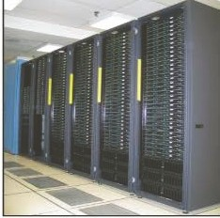
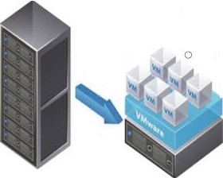
Linux
ADDITIONAL CHARACTERISTICS
In addition to the tasks performed by an operating system, Linux has the followin
characteristics
Supports clustering
Multiple Linux systems can be configured to appear as one system from the outside
Service can be configured among clusters and still offer a seamless user experience
Runs virtualization
Virtualization allow s one computer to appear as several computers to users Linux can be configured as a virtualization host
W hereyou could run other OS such as W indows, Mac OS, or other Linux systems
All the virtualized systems appear as separate systems to the outside world.
Server Virtualization
SOU RCE: Easy Linux For Beginners book by Felix Alvaro

Slide 15

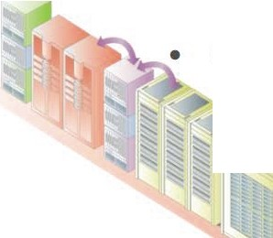
Linux
ADDITIONAL CHARACTERISTICS
Cloud Computing
Linux can handle complex, large-scale virtualization needs including
Virtual networking: a technology that facilitates data communication between two or more virtual machines (VM),
Networked storage,
Virtual guests (supports guest operating system using VM)
Options for Storage
Data need not always be stored in your computer's hard disk
Linux offers different local and networked storage options
SOU RCE: Easy Linux For Beginners book by Felix Alvaro

Slide 16
Linux
HISTORY
In 1992, Linux was licensed under GNU - General Public License (GPL) and the first Linux distributions (also called distro) were created
Several distributions have been created over time:
Slackware - the oldest existing distro,
Debian - the largest community distribution,
Red Hat and SUSE - commercial distributions
SOU RCE: Easy Linux For Beginners book by Felix Alvaro

Slide 17
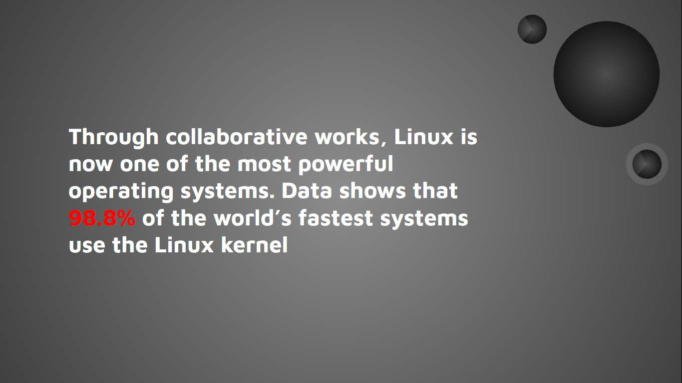

Slide 18


Slide 19
Linux
LINUX VS OTHER OS
Cost
Other than Linux commercial distributionsall other linux flavours are free
Viruses
Linux hardly gets any viruses
With many developers working on Linux, there are more eyes focused on seeing security flaws
System Stability
Linux is used in servers and supercomputers which cannot afford server restarts
Large-scale systems can go on for years without restarting the server
Installation
Linux flavours comes with text editor, spreadsheet, presentation program, photo editor, web browser, movie player, PDF reader, and the like
In other OS like windows etc we have to install all the other software that you need one-by-one
Support
Linux has a large community online where new users can get information,read FAQs, and ask questions if there are programs or features that you think are not working right
SOURCE: Easy Linux For Beginners book by Felix Alvaro

Slide 20


Slide 21
Linux
LINUX ARCHITECTURE
Linux architecture can be divided into two spaces
The User Space,
the Kernel Space
User Space
This is where the applications are used.
The GNU C library, in the User space, is the interface that connects to the kernel and transitions between User and Kernel space
This uses all the available memory
Kernel Space
All Kernel services are processed here. The Kernel space is further divided into 3
SOURCE: Easy Linux For Beginners book by Felix Alvaro

Slide 22
Linux
LINUX ARCHITECTURE
System Call Interface
o A User process can access Kernel space through a System Call
o When a System Call is performed, arguments are passed from User to Kernel space. This is the layer that implements basic functions
Kernel Code
o This is the architecture-independent code, and can be seen in all architecturesthat Linux supports.
User Applications
Architecture-Dependent Kernel Code
User
Space
GNU C Library (gllbc)
o This is the layer for platform-specific codes
GNU/ Linux
System Call Interface
Kernel
Kernel
Space
Architecture Dependent Kernel Code
Hardware Platform
SOURCE: Easy Linux For Beginners book by Felix Alvaro

Slide 23


Slide 24
Linux
LINUX DISTRIBUTIONS
Each Linux distribution consists of a Linux kernel plus utilities and configuration files
Most Linux distributions can be downloaded from their websites
Several of the popular Linux distributions, or flavours, differ from each other based on the following criteria
Availability
Linux is a free software, but companies offering a support contract and proprietary components offer it for a fee
Package Format
Linux distributions come in packages
Packages are files grouped into one single file. RPM is the most commonly used
SOURCE: Easy Linux For Beginners book by Felix Alvaro

Slide 25

Lin ux
LINUX DISTRIBUTIONS
Release Cycle
Distribution | Availability | Packagt Format | Release Cycle
Arch | Free | Pacrnan | Rolling
CentOS | Free | RPM | Approx. 2-vr
Debian | Free | D ebian | 2-yr
Fedora | Free | RPM | Approx. 6-mo
Gentoo | Free | £ b uild | Rolling
Mint | Free | Debian | 6-month
openSUSE | Free | RPtv1 | 8-month
Red Hat Enterprise | Commercial | RPM | Approx. 2-yr.
Scientific | Free | RPM | Approx. 6-mo
Slackware | Free | Tarballs | Irregular
SUSE Enterorise | Commercial | RPM | 2-3 vears
Ubtmtu | Free | Debian | 6-month
SOURCE: Easy Linux For Beginners book by Felix Alvaro

Slide 26


Slide 27
Linux
WHICH LINUX TO CHOOSE
Few thing can be considered before choosing any Linux flavour
Desktop environment
Do your research and find out if the particular distribution that you're eyeing has a basic look and feel that you like, pleasecheck how customizableit is
Hardware Compatibility
Checkhardware compatibility, some drivers might not be available yet by the time you install your distro
We can check from online resources first to know which ones can be supported out-of-the-box.
Community Support
Find the one with a large online community.
The bigger the community is,the easier it will be to find documentation and get support
SOURCE: Easy Linux For Beginners book by Felix Alvaro

Slide 28


Slide 29
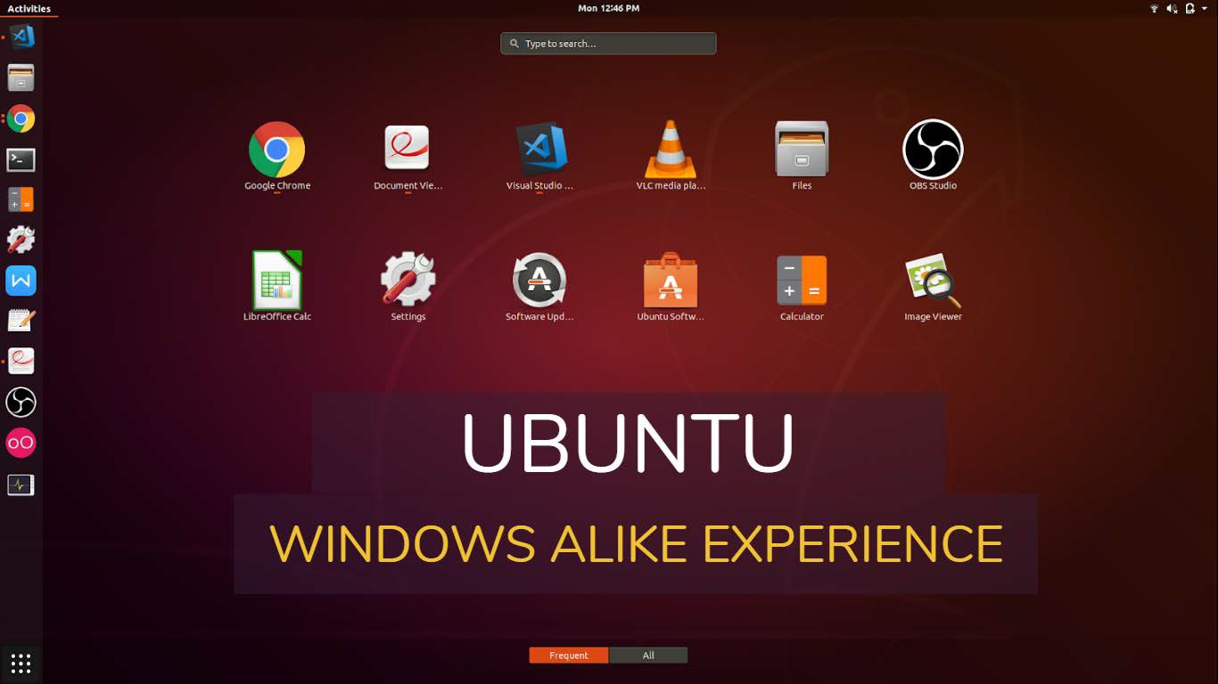

Slide 30


Slide 31
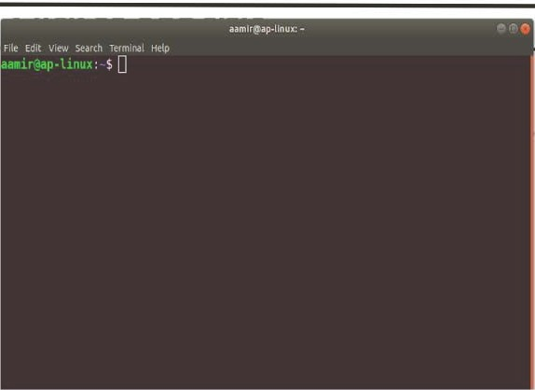
Linux
LINUX SHELL
Linux distribution uses the root username for administrator access
The desktop that comes up is either KDE or GNOME
The GUI for KDE or GNOME
provides the best way to explore Linux through icons, windows, and
pointers
Alternate to it is Terminal/ Console window
If you notice image above in which you will find aamir@ap-linux:-$
This is called shell
SOURCE: Easy Linux For Beginners book by Felix Alvaro

Slide 32
Linux
LINUX SHELL AND COMMANDS
The shell is where you can run executable files and shell scripts.
The shell is also what we call the command line. Commands are written using the general syntax below:
command option1 option2 ... optionN
For example you can try following command
aamir@ap-linux:~$ uptime
14:25:03 up 3 days, 13:15, 1 user, load average: 1.95,1.81, 1.07
uptime is the command that shows the duration that the computer has been up. In this case, the computer has been up f or the last 3 days
SOURCE: Easy Linux For Beginners book by Felix Alvaro

Slide 33
Linux
LINUX SHELL AND COMMANDS
For example you can try follow ing command
aamir@ap-linux:~$ uname -srv
Linux 4.15.0-46-generic #49-Ubuntu SMP Wed Feb 6 09:33:07 UTC 2019
uname is the command to show the operating system name.
-s (print the operating system name),
-r (print the operating system release),
-v (print the operating system version) are options that you can use for the uname command
aamir@ap-linux:~$ uname --help
Usage: uname [OPTION]...
Print certain system information. With no OPTION, same as -s.
-a' --all
print all information, in the following order, except omit -p and -i if unknown:
SOURCE: Easy Linux For Beginners book by Felix Alvaro

Slide 34
Linux
LINUX SHELL AND COMMANDS
To know about the options that you can use for a particular command, you can use the man command
aamir@ap-linux:~$ man uname
UNAME(1) User Commands
UNAME(1
)
NAME
uname - print system information SYNOPSIS
uname [OPTION]...
DESCRIPTION
Print certain system information. With no OPTION, same as -s.
-a --all
print all information, in the following order, except omit -p
and -i if unknown:
-s -kernel-name
print the kernel name
-n --nodename
SOURCE: Easy Linux For Beginners book by Felix Alvaro

Slide 35
Linux
ROOT USER
In computing, the superuser is a special user account used for system administration
The root user can do many things an ordinary user cannot for example install new software, removing any existing application, making change in any system settings etc.
Depending on the operating system (OS), the actual name of this account might be root, administrator, admin or supervisor
To switch to root while in the shell, enter the command su - and then input your root password
Changing to root password while in the shell environment will allow you to run tasks that only administrators and superusers can do
aamir@ap-linux:~$ su
Password:
root@ap-linux:/home/aamir# exit
exit
aamir@ap-linux:~$
SOURCE: Easy Linux For Beginners book by Felix Alvaro

Slide 36


Slide 37
Linux
LINUX DESKTOPS
There are two commonly used GUls that come with Linux distributions:
GNOME
Acronym for GNU Network Object Model Environm ent. (Pronounced guh-nome)
GNOME is a W indow s- like de sktop system that works on UNIX and UNIX-like systems and is not dependent on any one window manager
KDE
Acronym for K Desktop Environme nt
KDE GUI is equipped with everything users typically need, including a file manager, window manager, help tool and system configuration tool
You can have both installed in your computer and switch between the two whenever you want to
Both GUls also run on Unix, and while there are other GUls that can be installed on Linux, these two remain as the most popular in use
Source: https://www.webopedia.com/TERM/G/GNOME.html
SOURCE: Easy Linux For Beginners book by Felix Alvaro

Slide 38


Slide 39
Linux organizes files using a hierarchical system
Files are stored in directories and these directories can also contain other directories
When you compare the Linux filesystem to Windows, you will find that there are no drive letters in Linux
All files are stored in a single root directory noted as "/" regardless of where the data is physically stored (hard drive, external drive, or CR-ROM).
To find a file in Linux, you also need the information about the directory hierarchy known as the pathname
First-level
directory
Second-level
directory
Third-level
directory
Filename
/ | Home | / | edulaney | / | Public_html | / | Index.html
Root directory
Directory
separator
Name
Extension
SORCE: Easy Linux For Beginners book by Felix Alvaro

Slide 40
First-level
directory
Second-level
directory
Third-level
directory
Filename
/ | Home | / | edulaney | / | Public_html | / | Index.html
Root directory
Directory
separator
Name
Extension

Slide 41
Linux
LINUX FILESYSTEM
Top-Level Directory | Files that the directory contains
/ | Single root directory - file system base
/bin | Executablefiles such as Linux commands cat,cp,ls
/dev | Files for the different hardware/devices
/home | User directories
/lib | Library files which includes driver modules
/media | Mounting removable media filesystems (You can find C,D and other partitions in it )
/var | Log files
SOURCE:Easy Linux For Beginners book by Felix Alvaro

Slide 42
Linux
LINUX FILESYSTEM AND COMMANDS
To navigate in the directories on Linux, you can either use the
GUI to find a cert ain file by going through the folders,
Using the universaltext-basedsearclh funct ion,
By using the command line.
You can use the following useful commands in your terminalto navigate and work in the file system:
Commands | What it does
Is | List down all the contents of a director
cd /bin/ | Changes directory and goes to bin dir
cd- | the tilde (-) sign signifies the user's home dir - change dir to home director
SOURCE:Easy Linux For Beginners book by Felix Alvaro

Slide 43
LINUX FILESYSTEM AND COMMANDS
Commands What it does
cd .. | Means to change directory one level up
mkdir | A command used to create directories
pwd | Short for present working directory. This command will display the directory where you are currently in
cat <filename> | Command to print all the contents of provided filename on the screen
cp /home/ /tmp/ | Copy contents of /home/ to /tmp
mv /directoryName/file1.txt /newDirectoryName/ | Move the file file1.txt to the /newDirectoryName/ directory. You can also use this command to move the entire directory to another Directory
rm file1.txt | Delete the file file1.txt. Take extra precaution in using the rm command, especiallywhen you are logged in as root
find I -name "linux*" | The find command is a powerful tool that you can use when searching using the command line. The command here will search for any file or directory with a name that starts with linux

Slide 44


Slide 45
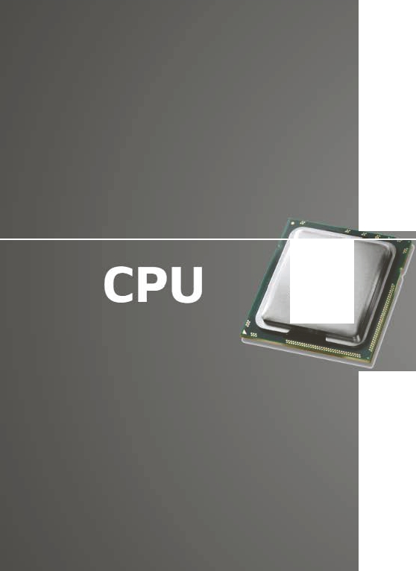


Slide 46
Linux
CPU - CENTRAL PROCESSING UNIT
The operating system keeps programs and hardware working together smoothly
The capabilities of Linux are affected by the limitations of your system's hard w are (for example, disk space and memory) so it is important to know more details about your computer's hardware
Let's start with the central processing unit (CPU), It is brain of your computer system
The CPU performs all the computing and its speed (in MHz) signifies how fast your computer can handle transactions
Your CPU specs will also tell you about the CPU family (most common are x86 and x86-64) and the number of "cores" that it has
To increase performance, manufacturers add additional "cores," or central processing units
Source: htt s://www.howto eek.com/194756/cpu-basics-multiple-cpus-cores-and-hyper-threading-explained/

Slide 47
Linux
CPU
For example a dual-core CPU has two central processing units, quard core has 4 central processing units so it appears to the operating system as two/four CPUs
A CPU with two cores, for example, could run two different processes at the same time.
This speeds up your system, because your computer can do multiple things at once
Commands What it does
uname -a | This command displays information about the machine, the processor architecture, and the operating system details.
lscpu | This command returns more information about the system such as the number of CPUs and the CPU speed
cat /proc/cpuinfo | This is a file that contains more information than the one displayed using the lscpu command
Source:
https://www.howtogeek.com/194756/cpu-basics-multiple-cpus-cores-and-hyper-threading-explained/
SOURCE: Easy Linux For Beginners book by Felix Alvaro

Slide 48
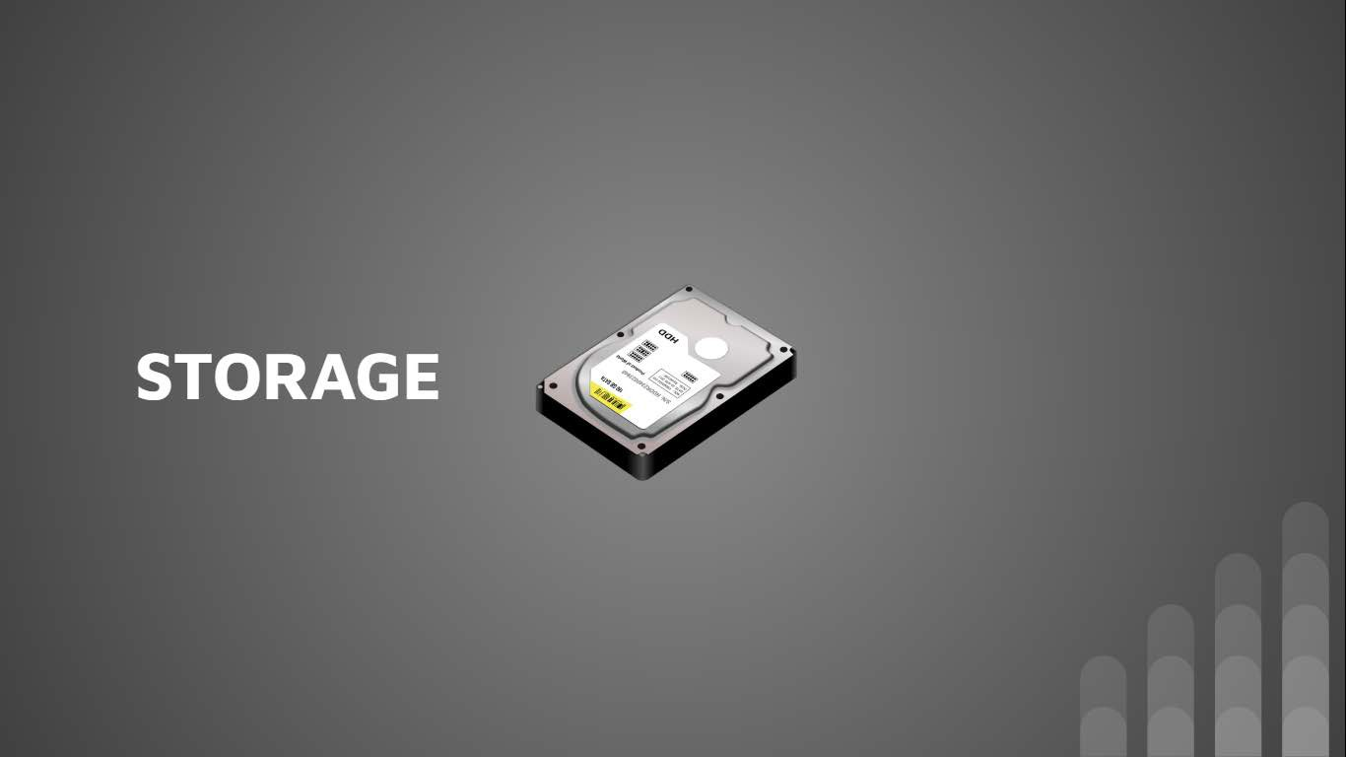

Slide 49
Linux
HARD DISK
The hard disk drive is the primary storage unit of the computer
This is where your data, programs and the operating system are physically saved in a binary form (Os and ls)
Earlier hard disk capacity is expressed in megabytes but now we got gigabytes (GB)
1 gigabyte is equals 1000 megabyte
More GBs your hard disk have, the more you can install programs or store documents into it
There could be more then one hard drive or you can split one hard drive into many logical partitions
Source: http://ecomputernotes.com/fundamental/input-output-and-memory/what-is-harddisk-hdd
SOURCE: Easy Linux For Beginners book by Felix Alvaro

Slide 50
Linux
HARD DISK
If you plan on adding a new disk in the future, learning how to partition will come in handy
A disk partition or partition is a section of the hard drive that is separated from other segiments
Partitions enable users to divide a physical disk into logical sections, For example C Drive, D Drive etc in windows operating system
Linux supports the many partitioning tools
•
GParted is a one of the free partition editor which can be downloaded and installed for graphically managing your disk partitions which can be download and used
SOURCE : Easy Linux For Beginners book by Felix Alvaro

Slide 51
Linux
HARD DISK
Here are some commands that you can use to check the existing disk space on your computer
Commands What it does
df-h | This command displays the disk space usage in all of the mounted devices. The -h option presents the results in a human readable output, using G for gigabytes or M for megabytes sizes
du -/Downloads | This command displays all the files inside the specified directory and their corresponding file sizes. You can also specify a filename
du -/Downloads -sh | The -s option provides the total file size of the specified directory and -h makes it human readable form
SOURCE : Easy Linux For Beginners book by Felix Alvaro

Slide 52


Slide 53
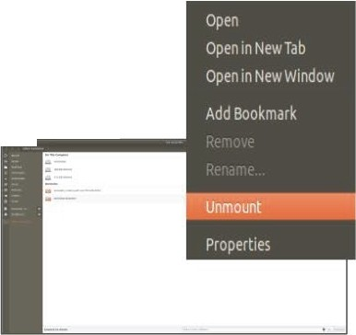
Linux
REMOVABLE STORAGE
Using storage such as USB flash drives and external hard disks in Linux works similarly when using Windows or Mac OS
Plug the device in and Linux will detect the device
Aside from accessing the drive via the desktop GUI, you can also navigate to the /media direct ory and find the mounted subdirectory
After you use the removable media, unmount the disk before removing it to avoid any disk issues
You can generally right-click on the Device Name and click on any of the options such as Unmount , Eject Volume, or Safely Remove
SOURCE: Easy Linux For Beginners book by Felix Alvaro

Slide 54


Slide 55
Linux
EXTERNAL USB DEVICES
You can connect other devices such as 1/0 devices (keyboard, mouse), cameras, mobile phones, scanners and printers to your Linux computer and expect that these work in a plug-and-play manner
For printers, you will also need to setup the printer configuration after Linux detects
the device
SOURCE: Easy Linux For Beginners book by Felix Alvaro

Slide 56


Slide 57
Linux
INSTALLING ADDITIONAL SOFTWARE
Linux-compatible softwares come in
.rpm for RPM packages (Fedore, SUSE)
RPM Package Manager (also known simply as RPM), originally called the Red-hat Package Manager, is a program for installing, uninstalling, and managing software packages in Linux
The .rpm files are used primarily by distributions that derive from Redhat based distros (Fedora, CentOS, RHEL) as w ell as by the openSuSE distro
.deb for Debian packages (Debian, Ulbuntu, Xandros)
A file with the DEB extension is a Debian Software Package fi le
The .deb files are meant for distributions of Linux that derive from Debian (Ubuntu, Linux Mint, Xandros etc.)
They're used mainly in Unix-based operating systems, including Ubuntu and iO
SOURCE: Easy Linux For Beginners book by Felix Alvaro

Slide 58
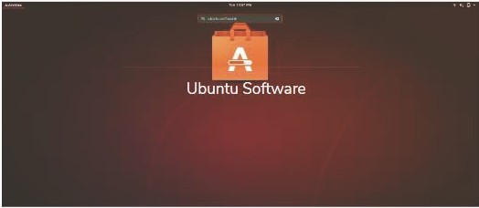


Linux
INSTALLING ADDITIONAL SOFTWARE
Both of the file with either .deb and .rpm are more akin to a .zip file
Even if the type of packages varies, both RPM and Debian packages can be installed in any type of Linux distribution
Popularly used distributions provide a GUI for installing add it ional applications
In Ubuntu you can use "Ubuntu Software" to find any app you want to install
Ubuntu Software is similar to Play Store and App Store we have in android and iOS
Ill -- - -·-- ·- - - -.-. ---· .... -........a. ·........ | - -.=.._=•=,_..._=_- -* | - | - _ u .. | -- ·- - | - | - | - | - • -_{W}-_{e}-
-
SOURCE: Easy Linux For Beginners book by Felix Alvaro

Slide 59
Linux
INSTALLING ADDITIONAL SOFTWARE
You also can install new software from Shell
Debian-based distros use APT or the Advanced Packaging Tool
apt-get install <package name>
For Example: apt-get install gparted
This command above will download the specific package name that you want to install
In case you do not know the package name, you can search for a keyword
apt-cache search <package name>
For Example:
apt-cache search screenshot
apt-cache search screenshot I grep GNOME
SOURCE: Easy Linux For Beginners book by Felix Alvaro

Slide 61


Slide 62


Slide 63
Linux
SHELL FEATURES
Previously we've been learned few command that we also tried on Shell / Command line
We will further learn different commands that you can use in Linux, and also study the different shell features
You have now seen the capabilities of using the Bash shell
Performing tasks on the command line take less t ime than doing it in the GUI
To further enjoy the convenience of using the CLI {command line interface), here are some shell features that you should use:
Command Completion: You can use TAB key to complete any unfinished command
apt-ca TAB - It will automatically make it apt-cache
DOUBLE-TAB will list all the available options on the screen
SOURCE: Easy Linux For Beginners book by Felix Alvaro

Slide 64
Linux
SHELL FEATURES
Command History: Linux remembers commands you have recently typed in so you no longer need to retype
Keys to Use Purpose
Arrow Up/Down | Display the previous commands from the more recent going to the oldest entered
Arrow Right/Left | Moves the cursor one character to the right/left
CTRL key+ A | Transfers cursor to the beginning of the line
CTRL key+ E | Transfers cursor to the end of the line
Delete key | The character under the cursor is deleted
Backspace | The character to the left of the cursor is removed
CTRL key+ R | Search for a particular command from the command history. After you use CTRL key + R, type the first few letters of the command that you want to use
SOURCE: Easy Linux For Beginners book by Felix Alvaro

Slide 65
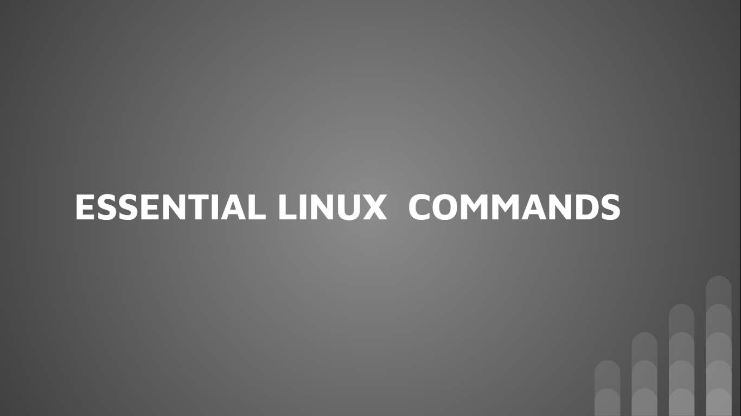

Slide 66
Linux
HELP COMMANDS
 |  | $ info uname
info | Shows online information about a command
man | Shows detalis (manual) of a command | $ man uname
whatis | Shows a short descirption of a specific keyword | $ whatis uname
type alias | Shows the location of a command file Assign a command alias - especially useful for longcommands | $ type uname
 |  | S alias t=type
 |  | $ t uname
 |  | S alias
unalias | Remove command alias | $ unalias t
SOURCE: Easy Linux For Beginners book by Felix Alvaro

Slide 67
Linux
MANAGING FILES AND DIRECTORIES
cd
 | Change directory | $ cd Desktop/
pwd | Displays the current directory | $ pwd
In | Create links to files and directories | $ln - s [file] [sof t-l i nk-to-f i l e] $ln -s abc. txt newAb c . txt
touch | To trigger a file stamp update for a file | $ touch abc.txt
find | Search for a file based on the name | $find [dir -p ath] -name [filename] $ find . -name ap . Jpeg
whereis | Search for executable files | $whereis uname
which | Search for files in the directories part of the PATH variable | $ which uname
SOURCE: Easy Linux For Beginners book by Felix Alvaro

Slide 68
Linux
PROCESSING FILES
dd
 | Copy linesof data | $ dd conv=ucase Type Hello world ctrl+d $ echo "hello world > abc.txt $ dd if=abc.txt of=newabc.txt conv=ucase $ cat newabc.txt
diff | Display the results of comparing two files | $ echo "hello world > abc.txt $ echo "hello world> abc1.txt $ diff abc.txt abc1.txt -s $ echo "hello world123 > newabc.txt $ diff abc.txt newabc.txt –s
more | Show a text file one page at a time - display can only go forward | $ Is -R > abc.txt $ more abc.txt $ Is-R | more
SOURCE: Easy Linux For Beginners book by Felix Alvaro

Slide 69
Linux
PROCESSING FILES
less
 | Show a text file one page at a time - display can only go forward and backwards | $ less abc.txt $ Is -R I less
WC | Display the count of the number of character,swords, and lines in a file | $ wc abc.txt
cat | Show a text file in one output | $ cat abc.txt
cut | Get sections of text in a file | $ cut -b 1 abc.txt $ cut -b 1-3 abc.txt $ cut -b 1,3 abc.txt
grep | Display results of finding expressions in a file | $ cat abc.txt I grep Desktop $ cat abc.txt I grep -i desktop $ grep -i "desktop" abc.txt
SOURCE: Easy Linux For Beginners book by Felix Alvaro

Slide 70

Linux
PROCESSING FILES
sed
 | Perform editing commands, then copy to a standard output | First occurance in every line will be changed $ sed 's/Desktop/Dashboard/' abc.txt 2nd occurance in every line will be changed $ sed 's/Desktop/Dashboard/2' abc.txt All occurances will be changed $sed 's/Desktop/Dashboard/g' abc.txt
split | Specify a size to break a file into | $ split abc.txt $ ls $ rm x* -1100 is 100 lines per file $ split-1100 abc.txt $ Is
sort | Arrange the lines in a file | S sort abc.txt
SOURCE: Easy Linux For Beginners book by Felix Alvaro

Slide 71
Linux
PROCESSING FILES
$ echo "Karachi Karachi
Lahore Islamabad Islamabad Lahore" > abc.txt
$ cat abc.txt
$ uniq abc.txt
$ uniq abc.txt –c
$ uniq abc.txt -d
uniq
Keep unique lines in a file and delete duplicates
SOURCE: Easy Linux For Beginners book by Felix Alvaro

Slide 72
Linux
DATE AND TIME
tar | Archive files with one or more directories | Archive the file $ tar –cf archive.tar file1 file2 Extract the files $ tar -xf archive.tar
cal | Show the calendar for the specified month or year | $ cal $ cal -3 $ cal -m 5 $ cal -y 2020
date | Show/Set the current date and time | $ date Sets the system date and time to given date $date -s "11/20/2003 12:48:00"
SOURCE: Easy Linux For Beginners book by Felix Alvaro

Slide 73
Linux
MANAGING PROCESSES
bg | Run a program or a process in the background | $ bg %[PID]
free | Check for the free memory | $ free
kill | Stop a process | $ kill <PSID>
nice | Run a program with a low priority, niceness values range from -20 to 19, with the former being most favorable, while latter being least | $ nice -10 Is -R $nice --1O Is -R
ps | Show current running processes | $ ps
top | Show list of CPU and memory utilization of processes | $top
SOURCE: Easy Linux For Beginners book by Felix Alvaro

Slide 74
Linux
MANAGING PROCESSES
reboot | Restart the computer | reboot
shutdown | Turn off computer | $ shutdown
SOURCE: Easy Linux For Beginners book by Felix Alvaro

Slide 75


Slide 76
Linux
BASIC ADMINISTRATION AND SECURITY
We have learned many useful linux commands
The next thing you should think about is securing it
System administrators consider two aspects of security
Host security
If multiple users are using a computer, user directories and files should be secured and should not be accessed by any unauthorized person
Network security
As your computer is connected to the internet, you have to protect it from access over the internet too
SOURCE: Easy Linux For Beginners book by Felix Alvaro

Slide 77
Linux
BASIC SYSTEM ADMINISTRATION
In linux GUI tools that can be used for performing administrative tasks
There are some of the activities that an administ rator executes
Adding and removing user accounts
Performingsoftware upgrades
Managing hardware
Installing new applications
Maintaining the system's performance
Setting up and monitoring security
SOURCE: Easy Linux For Beginners book by Felix Alvaro

Slide 78
SETTING
Lin ux
SOURCE: Easy Linux For Beginners book by Felix Alvaro

Slide 79
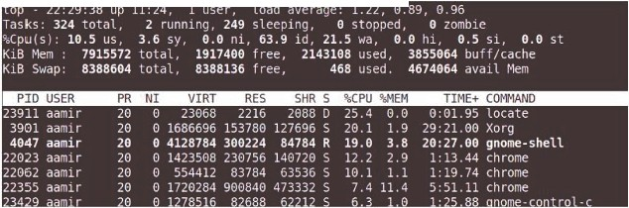
Linux
MONITORING SYSTEM PERFORMANCE
To effectively monitor your computer's performance, the following aspects should be checked
CPU and Memory Usage
top command can be used to see the processes that are consuming the most CPU resources and memory allocation
This command displays the
CPU load and used memory averages
Process IDs,
Percentage of CPU used by the process
Percentage of the memory used
The top command results are refreshed every 5 seconds.To exit the top command output display, press Q
SOURCE: Easy Linux For Beginners book by Felix Alvaro

Slide 80
Linux
MONITORING SYSTEM PERFORMANCE
To get a snapshot of the system status at the time the command was issued, use uptime
This command prints the load average for the last one, five, and fifteen minutes
aamir@ap-linux:~$ uptime
22:34:08 up 11:29, 1 user, load average: 0.63, 0.80, 0.92
SOURCE: Easy Linux For Beginners book by Felix Alvaro

Slide 81
HARD DISK SPACE
Linux
Monitor the hard disk space to ensure that there is enough space for the system to perform tasks such as logging and backups
df -h command is used to validate the disk space
aamir@ap-linux:~$ df -h
tmpfs 774M 2.2M 771M 1% /run
/dev/sda5 284G 110G 160G 41% /
tmpfs 3.8G 408M 3.4G 11% /dev/shm
tmpfs 5.0M 4.0K 5.0M 1% /run/lock
tmpfs 3.8G O 3.8G 0% /sys/fs/cgroup
/dev/sda3 293G 62G 232G 21% /media/aamir/905845D85845BDAA
/dev/sda2 342G 71G 271G 21% /media/aamir/44FCAE4FFCAE3B56
...
SOURCE: Easy Linux For Beginners book by Felix Alvaro

Slide 82
USER MANAGEMENT
Linux
Linux automat ically creates multiple user accounts upon installation, even if you are the only one using your computer
The system uses these accounts for running programs
Different accounts safeguard the system, including files and directories, from unauthorized access
Users can be assigned to groups for easier facilitation
To add, modify, or delete a user or group account, you can either use GUI or CLI
SOURCE: Easy Linux For Beginners book by Felix Alvaro

Slide 83
Linux
USER MANAGEMENT
Adding user from CLI need few steps/commands at CLI
First, login as root by using the command su
Password:
root@ap-linux:/home/aamir#
Add user by using following command syntax
root@ap-linux:/home/aamir# /usr/sbin/useradd -c "Test User" test
Once done with above command type passwd
root@ap-linux:/home/aamir# passwd
Enter new UNIX password:
Retype new UNIX password:
passwd: password updated successfully
root@ap-1inux:/home/aamir#
SOURCE: Easy Linux For Beginners book by Felix Alvaro

Slide 84
Linux
USER MANAGEMENT
To modify an account, use the usermod command
To delete the user account, use the /usr/sbin/userdel <username> command
To add a user group, you need to use the command groupadd <groupname>
For example, let's create a group named office. To create this group,
root@ap-linux:/home/aamir# groupadd office
To add test user which we create recently to above created office group
root@ap-linux:/home/aamir# usermod -G office test
To delete the group, use the command groupdel office
SOURCE: Easy Linux For Beginners book by Felix Alvaro

Slide 85
Linux
FILE OWNERSHIP
A user and group account owns a Linux file or directory. To see the owner of a particular file
aamir@ap-linux:~$ Is -1 <filename>
To change the ownership of any file from one user to another user
aamir@ap-linux:~$ chown <newuser> <filename>
To change the group owner of the file
aamir@ap-linux:~$ chgrp <newgroup> <filename>
SOURCE: Easy Linux For Beginners book by Felix Alvaro

Slide 86
Linux
FILES PROTECTION
To protect files from unauthorized access (viewing and modifying), revisit your file permissions setting
We just learned how to assign the user and group owner for a fi le
We may also need to specify the correct file permissions for the owner, the group, and global (all other users)
aamir@ap-linux:~$ Is -1 abc.txt
-rw-r--r-- 1 aamir aamir 51 Apr 10 01:03 abc.txt
If we look at the above result the first set of letters (in green) signifies the fi le permissions for the user. The next set (in blue) is for the group, while the section in orange stands for the global permission
r - permitted to read the file contents
w - permitted to write on the file
x - permitted to execute (if the file contains a bash script)
SOURCE: Easy Linux For Beginners book by Felix Alvaro

Slide 87


Slide 88
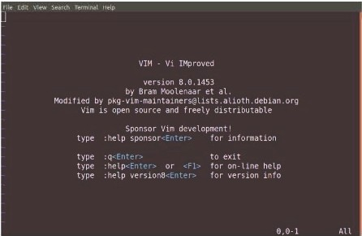
Linux
SCRIPTING
A shell script is a file containing a series of commands
The shell reads this file and carries out the commands as though they have been entered directly on the command line
You make shell script file from command line, linux has two default command line text editors
o Nano
o Vi
aamir@ap-linux:~$ nano
aamir@ap-linux:~$ vi
Many people around the world prefer vi but it is litt le different to use
SOURCE: Easy Linux For Beginners book by Felix Alvaro

Slide 89
Linux
Vi
Following are different command that are helpful when using vi
i Enter insert mode
U Undo
Ctrl+R Redo
o :w Save the current file
:wq Save the current file and close it; exits vim if no open files remain
:w newname Save a copy of the current file as 'newname,' but continue editing the original file
:sav newname Save a copy of the current file as 'newname' and continue editin g the file 'newname'
:q! Close a file without saving
:e somefile Opens file in the current buffer
:x Write any changes to the file and close the file
ESC To quit insert mode
There are quite a lot command keys for Vi but above are most required command keys
SOURCE: Easy Linux For Beginners book by Felix Alvaro

Slide 90
Linux
SCRIPTING
Scripts are useful in automating and simplifying administrative tasks, log monit oring of the system, and data processing
Let's create the simple script
aamir@ap-linux:~$ vi testscript.sh
#!/bin/sh
echo My name is: $1
echo This is the trial of shell script, Echo We are using $2 operating system
:wq!
SOURCE: Easy Linux For Beginners book by Felix Alvaro

Slide 91
Linux
SCRIPTING
After creating shell script we need to change fi le permission so that we could execute this file
aamir@ap-linux:~$ chmod 744 testscript.sh
Above 744 number refers to rwx for the user, read only for user group and global perm1ss1on
aamir@ap-linux:~$ chmod 744 testscript.sh
To run above created scrip
aamir@ap-linux:~$ ./testscript.sh aamir linux
My name is: aamir
This is the trial of shell script,
We are using linux operating system
SOURCE: Easy Linux For Beginners book by Felix Alvaro

Slide 92
Thank you and God bless you all!

